Slide 1
Running Kubernetes in Azure
Vaibhav gujral CLOUD ARCHITECT | Microsoft AZURE mvp
Notes:
Hey Everyone, I welcome you all to this session. I would like to thank the organizers of Boston Azure who have given me this opportunity to present in front of you all. I guess by now you will know that we are going to talk about running kubernetes in Azure. Before we jump onto that, a quick introduction about me.

Slide 2

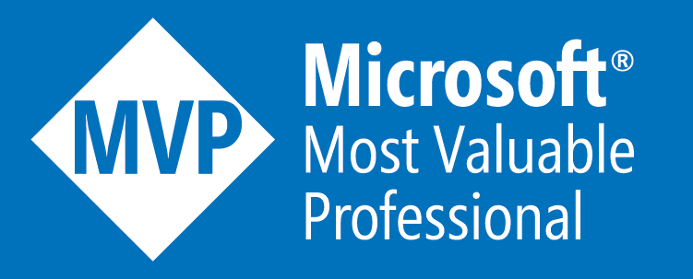
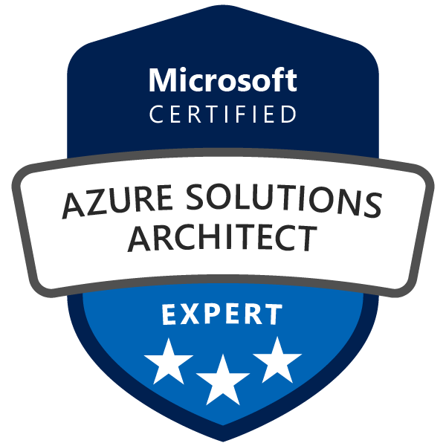
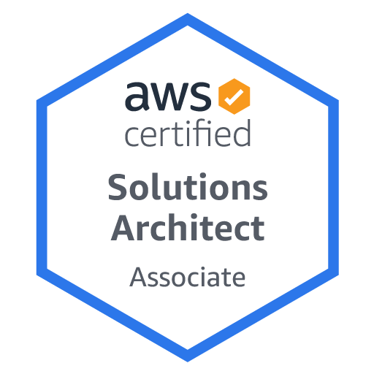
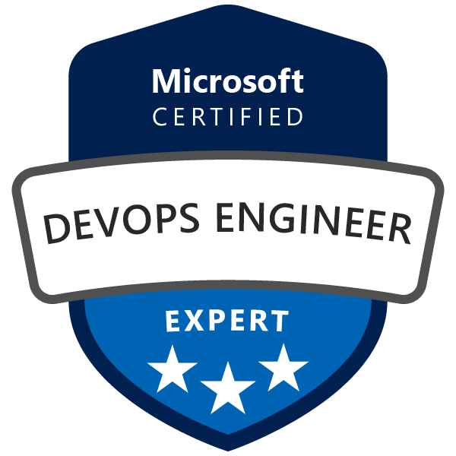
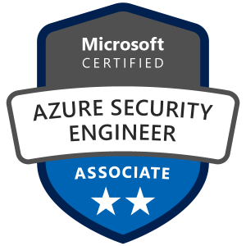
About me
Director, Global Microsoft Cloud CoE at Capgemini
Born and brought up in India and based out of Omaha, NE since 2016
Microsoft Azure MVP since 2020
Leader, Omaha Azure User Group(https://omahaazure.org)
15+ cloud certifications and counting…

Slide 3
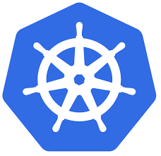
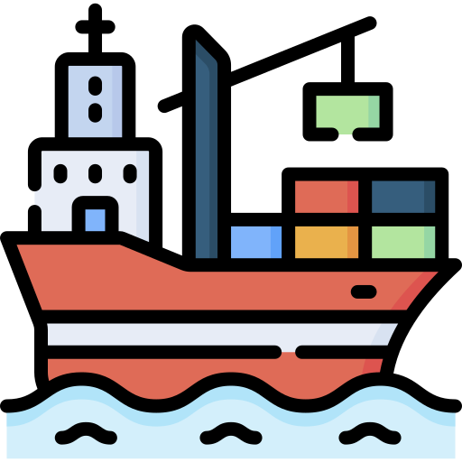
What is Kubernetes?
Kubernetes is a portable, extensible, open-source platform for automating the deployment, scaling, and management of containerized workloads.
Kubernetes (k(j)uːbərˈnɛtɪs)
Greek for “helmsman of a ship”
Notes:
We will start with very basics.. We will look into Kubernetes at a high level.. for the benefit of the people who have not worked on Kubernetes in the past. Then we will see how you can run kubernetes in Azure using a managed offering called as AKS.

Slide 4
Kubernetes History
First announced by Google in 2014
Heavily influenced by Google’s Borg system.
Original codename for Kubernetes project was Project 7 (a reference to the Star Trek ex-Borg character Seven of Nine)
V1.0 was released on July 21, 2015
Current version is 1.26.1 (released on 01/18/2023) (Release History)
Version 1.27 will be available 04/11/2023 (Schedule)
Originally written in C++, the current system is written in Go language.
https://vaibhavgujral.com/

Slide 5
Kubernetes Architecture – Big Picture
Control Plane
Workers Plane
Kubernetes
Core
Services
Your
Applications
Master Nodes
Worker Nodes
Kubernetes Cluster

Slide 6


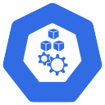
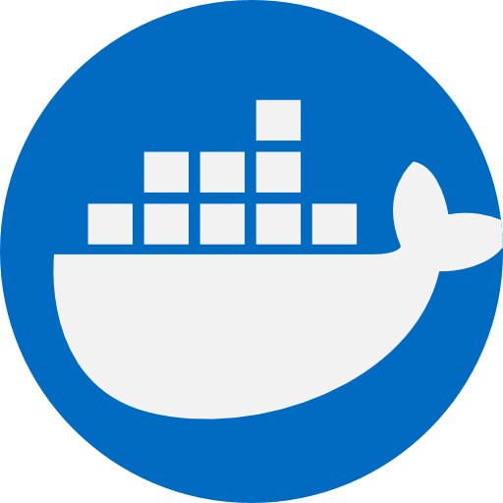
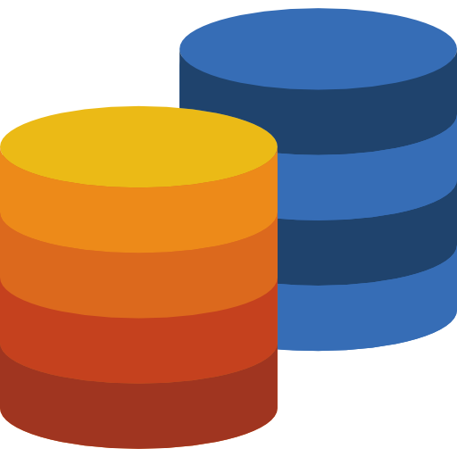

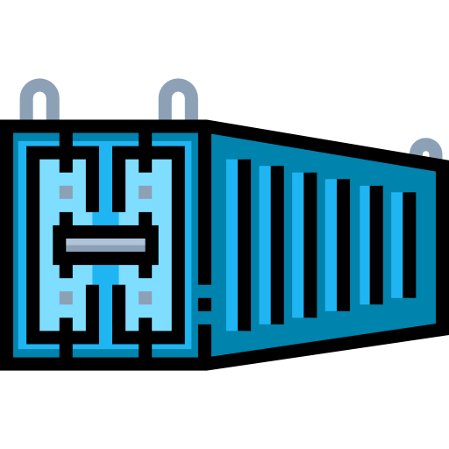
Kubernetes Architecture
API Server
Scheduler
kubelet
Container Runtime
etcd
Controller Manager
kube-proxy
Container
Control Plane
Worker Nodes

Slide 7
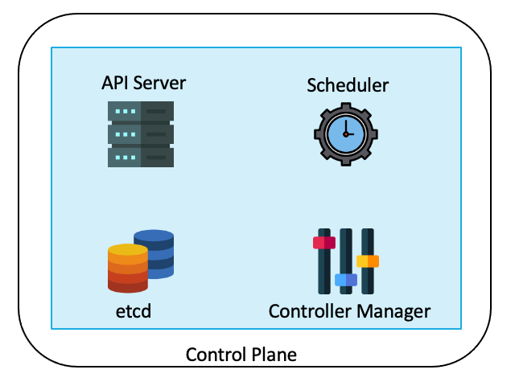
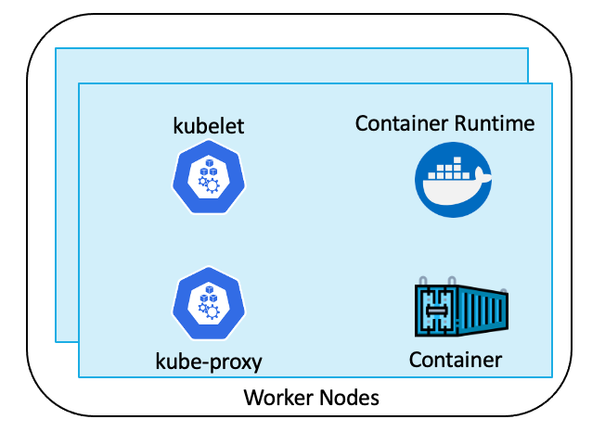
Kubernetes Components
Control Plane: manages the agent nodes and the pods in the cluster
api-server: front end of the Kubernetes control plane; exposes Kubernetes API
controller-manager: runs the controller processes
scheduler: tracks newly created pods and selects node to run them on
etcd: stores the state of the cluster (config, running workloads status, etc.)
Worker nodes: run your application workloads
Pods: a collection of containers co-located on a single machine
kube-proxy: a network proxy that runs on each node in a cluster
kubelet: agent that runs on each node in a cluster; ensures containers are running in a pod
Container Runtime: software responsible for running containers

Slide 8
Kubernetes Core Concepts
Pods are smallest unit in Kubernetes providing an abstraction over containers. Pods are ephemeral and get their own IP Address.
Services provide a persistent IP Address for a set of pods running an application and acts like a load balancer. The lifecycle of a service is not linked to the lifecycle of a pod.
Ingress exposes HTTP and HTTPS routes from outside the cluster to services within the cluster.
ConfigMaps are text-based key-value stores to store the external configuration for your application.
Secrets are base-64 encoded store for confidential data like passwords and secrets.
Volumes offer data storage for persistent data that needs to exist beyond the lifecycle of a pod.

Slide 9
Kubernetes Core Concepts
A ReplicaSet's purpose is to maintain a stable set of replica Pods running at any given time.
A Deployment provides declarative updates for Pods and ReplicaSets.
A StatefulSet is similar to deployment, but it maintains a sticky identity for each of their Pods.
A DaemonSet is used for deploying ongoing background tasks that you need to run on all or certain nodes, and which do not require user intervention.
A Job creates one or more Pods and continues to retry execution of the Pods until a specified number of them successfully terminate.
A CronJob creates Jobs on a repeating schedule.

Slide 10
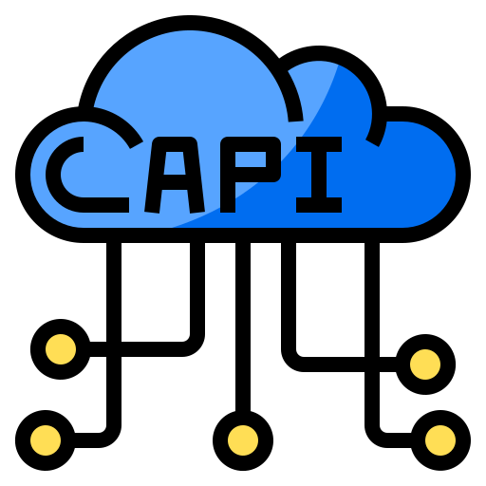
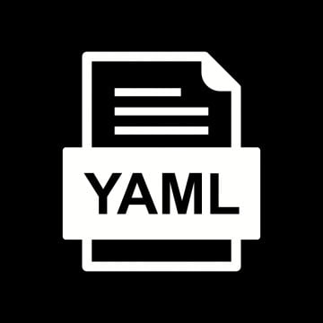
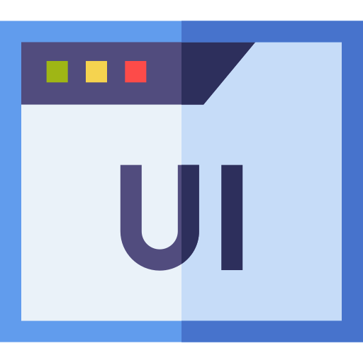
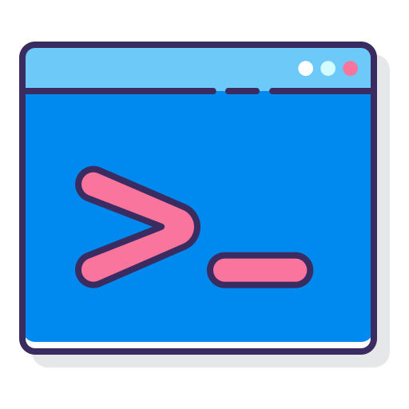
Managing Kubernetes Cluster
API Server
Scheduler
kubelet
Container Runtime
kubectl
etcd
Controller Manager
kube-proxy
Container
Control Plane
Worker Nodes
GitHub - kelseyhightower/kubernetes-the-hard-way: Bootstrap Kubernetes the hard way on Google Cloud Platform. No scripts.

Slide 11

=
Azure
Kubernetes
Azure Kubernetes Service

Slide 12
Azure Kubernetes service
Hosted Kubernetes service in Azure
Reduces the complexity and operational overhead of managing Kubernetes
The control plane is provided as a managed Azure resource abstracted from the user
The control plane includes the core Kubernetes components like kube-apiserver, etcd, kube-scheduler and kube-controller-manager
An AKS cluster has one or more worker nodes, which is an Azure virtual machine (VM) that runs the Kubernetes node components and container runtime
You only pay for worker nodes and control plane comes at no charge to you
https://docs.microsoft.com/en-us/azure/aks/
Notes:
Speaking of Azure, there is a hosted Kubernetes service available in Azure which is called as Azure Kubernetes service
Being a managed service, it reduces the complexity and operational overhead of managing Kubernetes tremendously.
In AKS, the cluster master is provided as a managed Azure resource abstracted from the user. The cluster master includes the core Kubernetes components like kube-apiserver, etcd, kube-scheduler and kube-controller-manager
An AKS cluster has one or more nodes, which is an Azure virtual machine (VM) that runs the Kubernetes node components and container runtime
For more information on Azure Kubernetes service, check out the link provided down below
https://docs.microsoft.com/en-us/azure/aks/

Slide 13

Azure Kubernetes Service
Managed by Azure
Managed by Customer
API Server
Scheduler
kubelet
Container Runtime
etcd
Controller Manager
kube-proxy
Container
Control Plane
Worker Nodes

Slide 14
Shared Responsibility
Responsibilities | DIY with Kubernetes | Managed Kubernetes on Azure
Containerization
Application iteration, debugging
CI/CD
Provisioning, upgrades, patches
Reliability availability
Scaling
Monitoring and logging
Azure managed control plane
App/ workload definition
Self-managed master node(s)
Kubernetes API endpoint
etcd Store
User
API server
Scheduler
Controller Manager
Cloud Controller
Schedule pods over private tunnel
Customer VMs
Docker
Docker
Docker
Docker
Docker
Pods
Pods
Pods
Pods
Pods
Customer
Microsoft

Slide 15
Benefits of AKS
Azure managed control plane
Automated upgrades, patches
High reliability, availability
Easy, secure cluster scaling
Self-healing
API server monitoring
At no charge
Self-managed master node(s)
App/ workload definition
Kubernetes API endpoint
etcd Store
User
API server
Scheduler
Controller Manager
Cloud Controller
Schedule pods over private tunnel
Customer VMs
Docker
Docker
Docker
Docker
Docker
Pods
Pods
Pods
Pods
Pods

Slide 16
Create/Configure AKS Cluster
Using Azure Command Line Interface (CLI)
az aks create --resource-group myResourceGroup --name myAKSCluster --node-count 1 --generate-ssh-keys
Using Azure PowerShell
New-AzAksCluster -ResourceGroupName myResourceGroup -Name myAKSCluster -NodeCount 1
Using Azure Portal
Using ARM Templates and Bicep
Using Azure REST API
PUT https://management.azure.com/subscriptions/{subscriptionId}/resourceGroups/{resourceGroupName}/providers/Microsoft.ContainerService/managedClusters/{resourceName}?api-version=2021-05-01

Slide 17
Manage Azure Kubernetes Service
Task | The Old Way | With Azure
Create a cluster | Provision network and VMs Install dozens of system components including etcd Create and install certificates Register agent nodes with control plane | az aks create
Upgrade a cluster | Upgrade your master nodes Cordon/drain and upgrade Agent nodes individually | az aks upgrade
Scale a cluster | Provision new VMs Install system components Register nodes with API server | az aks scale

Slide 18



Slide 19
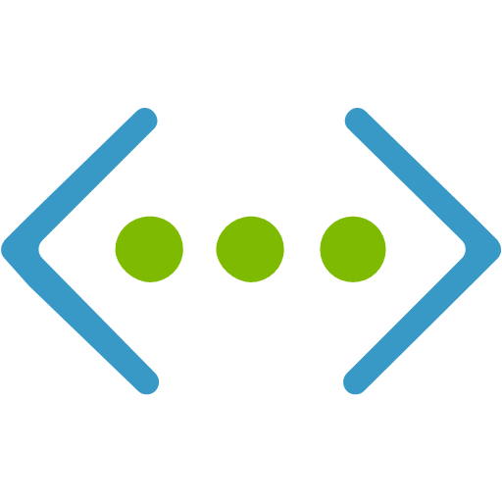
AKS Networking
Two different options -
Kubenet networking - The network resources are typically created and configured as the AKS cluster is deployed.
Pod
Pod
Container
IP
……...
Container
IP
Subnet A
DB
App
10.10.0.0
10.10.0.n
192.168.0.0/20
Pods CIDR Range
Node
IP
192.168.0.0
10.10.0.1/16

Slide 20

Pod
Pod
10.10.0.1/16 -> 192.168.0.0
10.11.0.1/16 -> 192.168.0.1
Container
IP
……...
Container
IP
DB
App
Route Table
10.11.0.0
10.11.0.n
Pods CIDR Range
Node
IP
192.168.0.1
10.11.0.1/16
Pod
Pod
Container
IP
……...
Container
IP
DB
Subnet A
10.10.0.0
App
10.10.0.n
192.168.0.0/20
Pods CIDR Range
Node
IP
192.168.0.0
10.10.0.1/16

Slide 21
AKS Networking
Two different options -
Azure Container Networking Interface (CNI) networking - The AKS cluster is connected to existing virtual network resources and configurations.
Pod
Pod
Container
IP
……...
Container
IP
DB
App
192.168.0.1
192.168.0.n
Node
IP
192.168.0.0
Subnet A
192.168.0.0/20

Slide 22
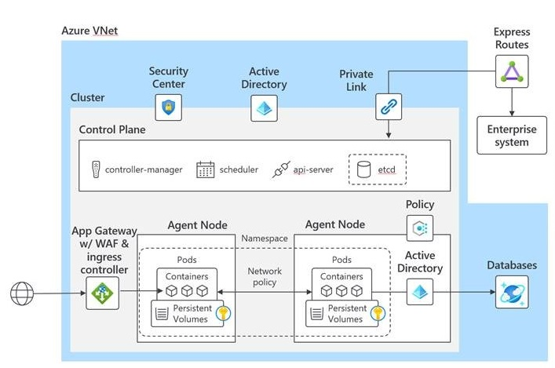
AKS Security
Enforce compliance rules with Azure Policy
Identity and access control using Azure Active Directory
Encrypt using your own keys, stored in Azure Key Vault
Gain unmatched security management with Azure Security Center integration
Interact securely with Kubernetes API server using Azure Private Link
Use application gateway (and WAF) with Ingress Controller
Notes:
AKS comes with different security options that you can utilize. To start with, you can utilize Azure policies to enforce compliance on your AKS clusters… similar to how you use azure policies with any other resource type
Though Kubernetes comes with its own RBAC, you can utilize Azure AD for identity and access control for your AKS clusters.
AKS supports encryption at rest for all the persisted data. By default, the data is encrypted using a Microsoft provided key. But, you get an option to use your own key for encryption
Azure Security center is a tool for security posture management across your azure environment including your AKS clusters. Azure Security center and azure defender has been combined now to be known as Microsoft Defender for Kubernetes which offers protection not just for your AKS clusters but rather any Kubernetes cluster running anywhere.
In some situations, you would like your Kubernetes API Server to be truly private and inaccessible from public internet. You can achieve so by using a service called Azure private link which only allows incoming traffic from your private network and returns 403-forbidden from everywhere else.
Lastly you can also use Azure application gateway along with Web application firewall with the ingress controller for your AKS cluster to improve your security posture.

Slide 23
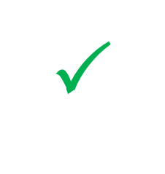
AKS Governance with Azure Policies
Cloud Architect
Azure Policy
Cloud architect assigns a deployment policy across cluster(s)
Developer uses standard Kubernetes API to deploy to the cluster
Compliance reports
Assigns a policy across clusters
Cluster-1
Cluster-2
Cluster-3
Compliance reports for the entire environment, with pod-level granularity
Real-time deployment enforcement (acceptance/denial) provided to developer based on policy
Real-time enforcement of policy and feedback
AKS
Cloud architect obtains compliance report for the entire environment and can drill down to individual pod level
Developer
Cluster-1
Cluster-2
Cluster-3

Slide 24
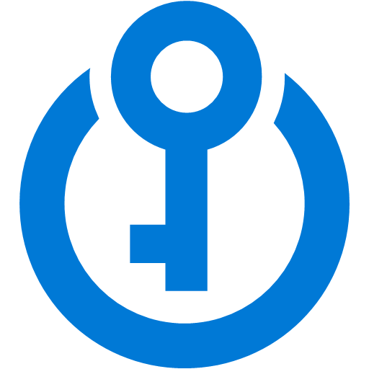
AKS Identity and Management
Storage
AKS with RBAC
Active Directory
VNet
Active Directory
SQL Database
Node
Node
Synced identity
Pod
Pod
AAD Pod Identity
Cosmos DB
Key Vault
Notes:
Use familiar tools like AAD for fine-grained identity and access control to Kubernetes resources from cluster to containers.
You can authenticate, authorize, secure, and control access to Kubernetes clusters in a variety of ways.
Using Kubernetes role-based access control (Kubernetes RBAC), you can grant users, groups, and service accounts access to only the resources they need. You create roles and cluster roles and assign them to the bindings. Bindings Assign roles to users for a given namespace or the whole cluster.
With Azure Kubernetes Service (AKS), you can further enhance the security and permissions structure via Azure Active Directory and Azure RBAC.
Kubernetes RBAC and AKS help you secure your cluster access and provide only the minimum required permissions to developers and operators. Azure offers several built in RBAC roles like Azure Kubernetes Service RBAC Reader, Azure Kubernetes Service RBAC Writer, Azure Kubernetes Service RBAC Admin and Azure Kubernetes Service RBAC Cluster Admin
Today with Azure Kubernetes Service (AKS), you can assign managed identities at the pod-level, which has been a preview feature. This pod-managed identity allows the hosted workload or application access to resources through Azure Active Directory (Azure AD). For example, a workload stores files in Azure Storage, and when it needs to access those files, the pod authenticates itself against the resource as an Azure managed identity. This authentication method has been replaced with Azure Active Directory (Azure AD) workload identities (preview), which integrate with the Kubernetes native capabilities to federate with any external identity providers. This approach is simpler to use and deploy, and overcomes several limitations in Azure AD pod-managed identity:
Removes the scale and performance issues that existed for identity assignment
Supports Kubernetes clusters hosted in any cloud or on-premises
Supports both Linux and Windows workloads
Removes the need for Custom Resource Definitions and pods that intercept Azure Instance Metadata Service (IMDS) traffic
Avoids the complicated and error-prone installation steps such as cluster role assignment from the previous iteration

Slide 25
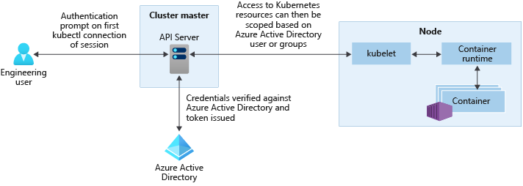
AKS Identity and Management
https://docs.microsoft.com/en-us/azure/aks/concepts-identity#azure-ad-integration
Notes:
With Azure AD-integrated AKS clusters, you can grant users or groups access to Kubernetes resources within a namespace or across the cluster.
To obtain a kubectl configuration context, a user runs the az aks get-credentials command.
When a user interacts with the AKS cluster with kubectl, they're prompted to sign in with their Azure AD credentials.
This approach provides a single source for user account management and password credentials. The user can only access the resources as defined by the cluster administrator.
Azure AD authentication is provided to AKS clusters with OpenID Connect. OpenID Connect is an identity layer built on top of the OAuth 2.0 protocol. From inside of the Kubernetes cluster, Webhook Token Authentication is used to verify authentication tokens. Webhook token authentication is configured and managed as part of the AKS cluster.

Slide 26
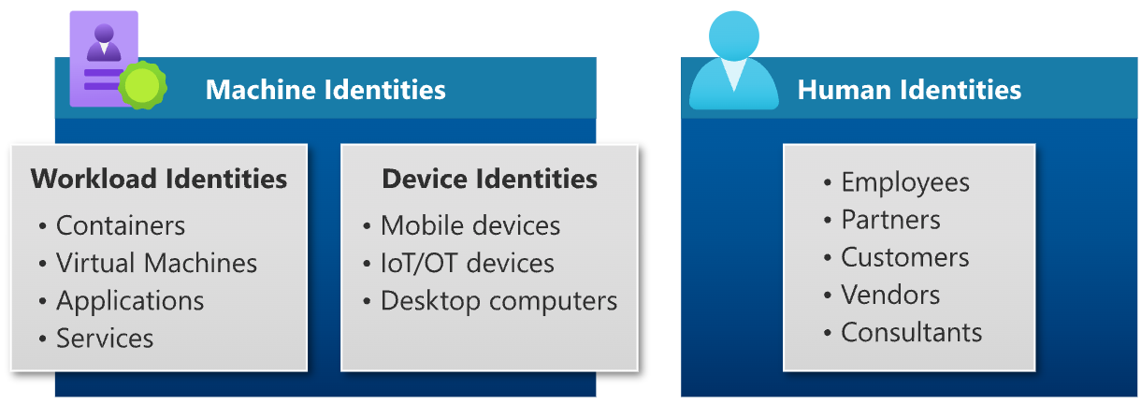
Azure AD Workload Identities
Used by a software workload (such as an application, service, script, or container) to authenticate and access other services and resources.
In Azure Active Directory (Azure AD), workload identities are applications, service principals, and managed identities.
Notes:
A workload identity is an identity used by a software workload (such as an application, service, script, or container) to authenticate and access other services and resources. The terminology is inconsistent across the industry, but generally a workload identity is something you need for your software entity to authenticate with some system
In Azure Active Directory (Azure AD), workload identities are applications, service principals, and managed identities.
An application is an abstract entity, or template, defined by its application object. The application object is the global representation of your application for use across all tenants. The application object describes how tokens are issued, the resources the application needs to access, and the actions that the application can take.
A service principal is the local representation, or application instance, of a global application object in a specific tenant. An application object is used as a template to create a service principal object in every tenant where the application is used. The service principal object defines what the app can actually do in a specific tenant, who can access the app, and what resources the app can access.
A managed identity is a special type of service principal that eliminates the need for developers to manage credentials.

Slide 27
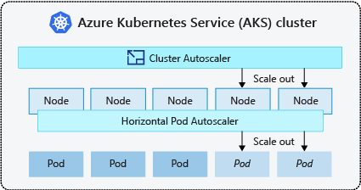
AKS Auto-scaling
The cluster autoscaler watches for pods that can't be scheduled on nodes because of resource constraints. The cluster then automatically increases the number of nodes.
The horizontal pod autoscaler uses the Metrics Server in a Kubernetes cluster to monitor the resource demand of pods. If an application needs more resources, the number of pods is automatically increased to meet the demand.

Slide 28
Kubernetes-based event-driven auto-scaling (KEDA)
Open-source component jointly built by Microsoft and RedHat
Event-driven container creation & scaling Allows containers to “scale to zero” until an event comes in, which will then create the container and process the event, resulting in more efficient utilization and reduced costs
​Native triggers support Containers can consume events directly from the event source, instead of routing events through HTTP
​Can be used in any Kubernetes service This includes in the cloud (e.g., AKS, EKS, GKE, etc.) or on-premises with OpenShift—any Kubernetes workload that requires scaling by events instead of traditional CPU or memory scaling can leverage this component.
Kubernetes cluster
Scaler
AKS cluster
External trigger source
Controller
Metrics adapter
KEDA
https://docs.microsoft.com/en-us/azure/azure-functions/functions-kubernetes-keda

Slide 29
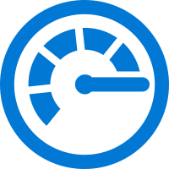
Azure Monitor for Containers
Visualization
Visualize overall health and performance from clusters to containers with drill downs and filters
Observability
Insights
Provide insights with multi-cluster health roll up view
Azure Pipelines
Kubernetes control
Azure Monitor for containers
Monitor & Analyze
Monitor and analyze Kubernetes and container deployment performance, events, health, and logs
Response
Native alerting with integration to issue managements and ITSM tools
ACI burst from AKS
Observability
Observe live container logs on container deployment status
Notes:
Get detailed insights about your workloads with Azure monitor
Filter for details about nodes, controllers and containers
See graphical insights about clusters
Pull events and logs for detailed activity analysis

Slide 30
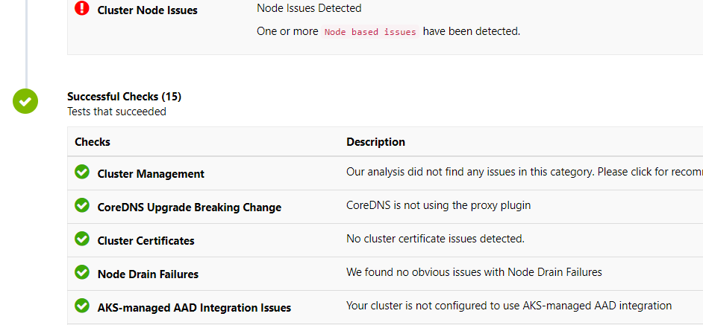

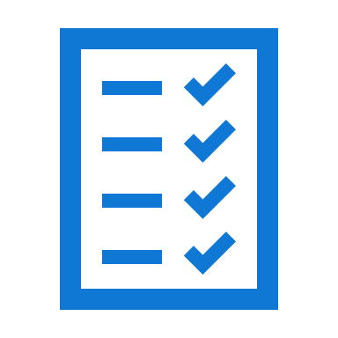
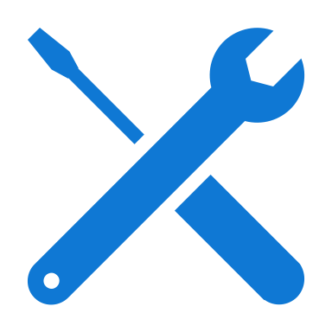
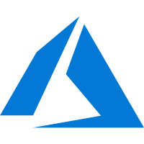
AKS Diagnostics
Faster resolution of common issues with an intelligent, self-diagnostic experience right in the portal
Cluster-specific observations
Recommended actions for troubleshooting
AKS diagnostics Sample diagnostics web portal
<\>
Zero configuration and zero cost
Intelligent detectors based on AKS-specific telemetry
Cluster-specific observations
Recommended actions for troubleshooting
Azure portal
Azure backend telemetry
AKS production cluster
User
Node 1
Node 2
Notes:
AKS Diagnostics is an intelligent, self-diagnostic experience that:
Helps you identify and resolve problems in your cluster.
Is cloud-native.
Requires no extra configuration or billing cost.

Slide 31
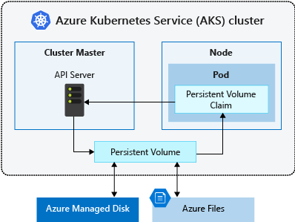
AKS Storage Options

Slide 32
Azure Container registry
First-class Azure resource
Managed, private Docker registry service based on the open-source Docker Registry 2.0.
Can be used with existing container development and deployment pipelines
Use Azure Container Registry Tasks to build container images in Azure
Three pricing tiers:
Basic
Standard
Premium
https://azure.microsoft.com/en-us/pricing/details/container-registry/
https://docs.microsoft.com/en-us/azure/container-registry/container-registry-skus
Notes:
Lets start with Azure Container registry or ACR in short which is a first class azure resource. It’s a managed, private docker registry service based on the open source Docker registry 2.0
You can use ACR with existing container development and deployment pipelines. You can use ACR tasks to build your container images in azure.
You can also use docker cli to push images to ACR just like how you will push into any other container registry
ACR comes with three service tiers – basic, standard and premium. With basic being the smallest tier and premium is the most feature rich tier.
Basic tier comes with 10 Gigs of storage space, Standard comes with 100 Gigs and Premium comes with 500 Gigs of storage space
Unlike basic and standard tier, premium tier supports additional features like geo-replication, private links, customer managed keys for encryption of data at rest and so on
Check out the links I have provided down below for ACR pricing and the difference between the three service tiers.

Slide 33
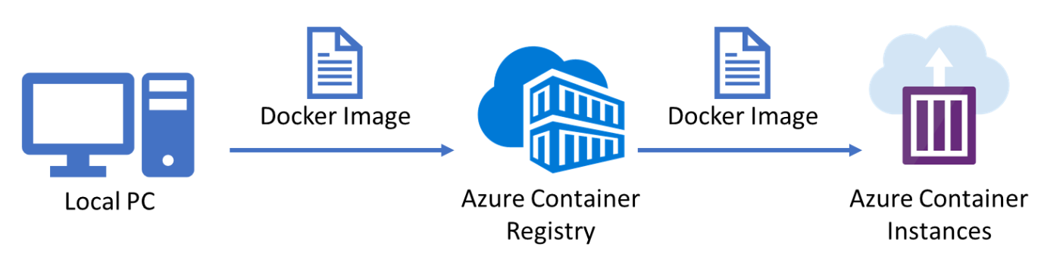
Azure container instances
Fastest and simplest way to run a container in Azure
https://docs.microsoft.com/en-us/azure/container-instances/
Notes:
Moving on, Azure Container Instances offers the fastest and simplest way to run a container in Azure, without having to manage any underlying infrastructure like virtual machines and so on.
Azure Container Instances are best suited for any scenario that can operate in isolated containers, including smaller applications, task automation, and build jobs.
For running your containers, the flow is straight forward. You create a docker image and push it into azure container registry or any other container registry. And then your azure container instances run containers based on those images.

Slide 34
Serverless Kubernetes with Virtual Nodes
Node
Node
Elastically provision compute capacity in seconds
No infrastructure to manage
Built on open sourced Virtual Kubelet technology, donated to the Cloud Native Computing Foundation (CNCF)
Pods
Pods
Azure Container Instances (ACI)
Kubernetes control plane
Pods
Virtual node

Slide 35
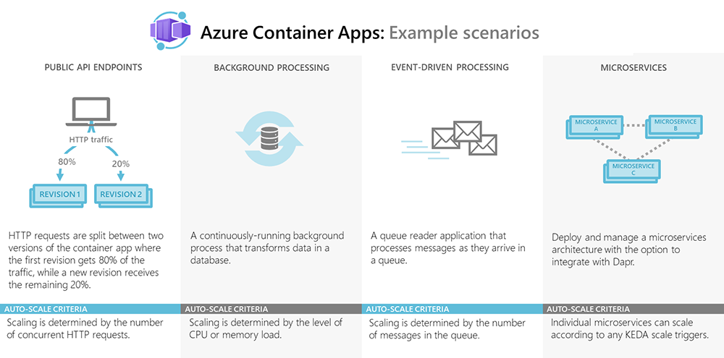
Azure Container Apps
Azure Container Apps enables you to run microservices and containerized applications on a serverless platform.

Slide 37
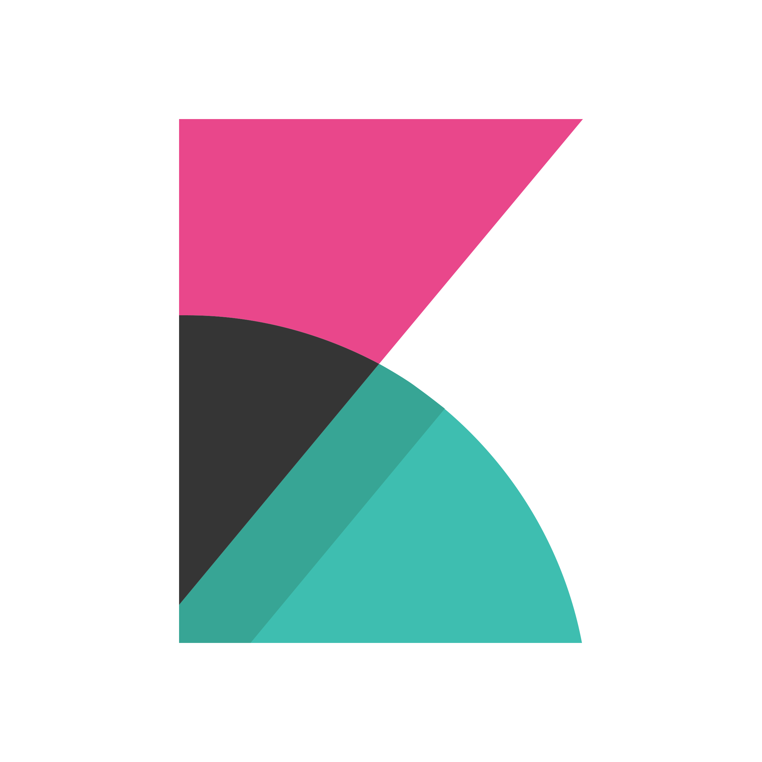
CI/CD using Azure DevOps
Azure Container Registry
Engineer
5
Azure Kubernetes Service
Azure SQL Database
4
1
1
2
3
6
Visual Studio Code
Azure Repos
Azure Pipelines
8
Azure DevOps
7
Kiabana
Azure Monitor
37
Notes:
A developer makes changes to the Node.js web application source code.
The code change is committed to a source control repository, such as GitHub.
To start the continuous integration (CI) process, a GitHub webhook triggers a Jenkins project build.
The Jenkins build job uses a dynamic build agent in Azure Kubernetes Service to perform a container build process.
A container image is created from the code in source control, and is then pushed to an Azure Container Registry.
Through continuous deployment (CD), Jenkins deploys this updated container image to the Kubernetes cluster.
The Node.js web application uses Cosmos DB as its back end. Both Cosmos DB and Azure Kubernetes Service report metrics to Azure Monitor.
A Grafana instance provides visual dashboards of the application performance based on the data from Azure Monitor.

Slide 38

CI/CD using GitHub and Jenkins
Azure Container Registry
Engineer
5
Azure Kubernetes Service
Azure SQL Database
4
1
1
2
3
6
Visual Studio Code
GitHub
Jenkins
8
7
Grafana
Azure Monitor
38
Notes:
A developer makes changes to the Node.js web application source code.
The code change is committed to a source control repository, such as GitHub.
To start the continuous integration (CI) process, a GitHub webhook triggers a Jenkins project build.
The Jenkins build job uses a dynamic build agent in Azure Kubernetes Service to perform a container build process.
A container image is created from the code in source control, and is then pushed to an Azure Container Registry.
Through continuous deployment (CD), Jenkins deploys this updated container image to the Kubernetes cluster.
The Node.js web application uses Cosmos DB as its back end. Both Cosmos DB and Azure Kubernetes Service report metrics to Azure Monitor.
A Grafana instance provides visual dashboards of the application performance based on the data from Azure Monitor.

Slide 39
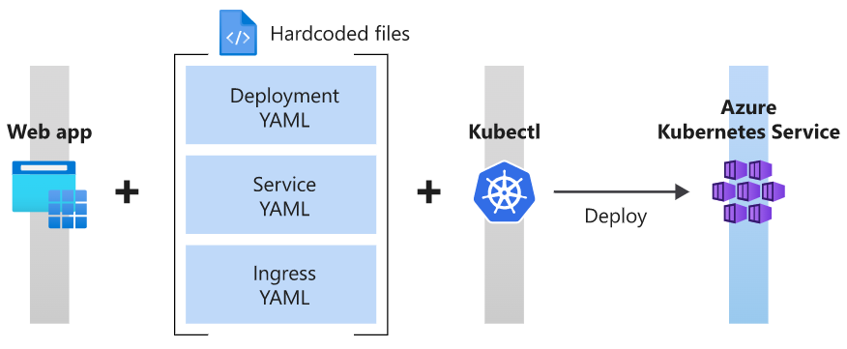
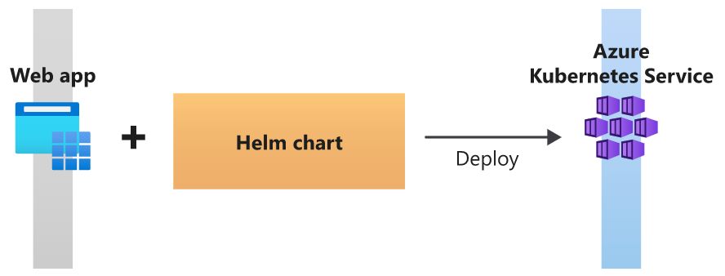
Helm Package Manager
Helm is a package manager for Kubernetes that combines all your application's resources and deployment information into a single deployment package.

Slide 40
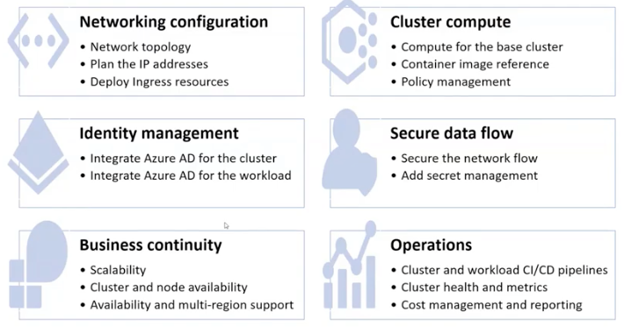
AKS – Best Practices
https://docs.microsoft.com/en-us/azure/aks/best-practices

Slide 41
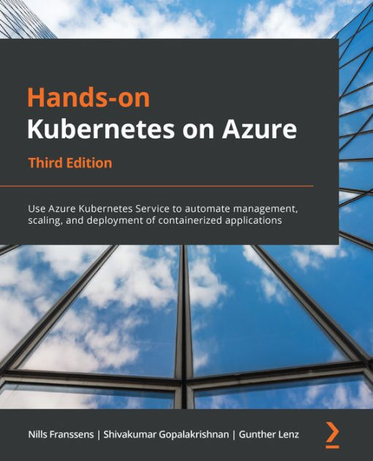
Further Reading
Kubernetes on Azure - https://aka.ms/K8sonAzure
Microsoft Learn - https://aka.ms/LearnKubernetes
What is Kubernetes - https://aka.ms/k8sLearning
AKS Case Studies - https://aka.ms/AKS/casestudy
AKS Roadmap - https://aka.ms/k8sroadmap
Getting started for free - https://aka.ms/AKS/trial

Slide 42


Slide 43





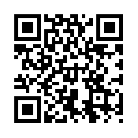
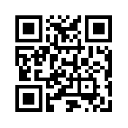
Contact Information
https://vaibhavgujral.com
@vaibhavgujral_
https://www.linkedin.com/in/vaibhavgujral/
https://www.youtube.com/c/VaibhavGujral
vaibhav@vaibhavgujral.com
LinkedIn
Twitter
Email

Slide 44
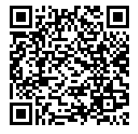
Slides

Slide 45


